Slide 1
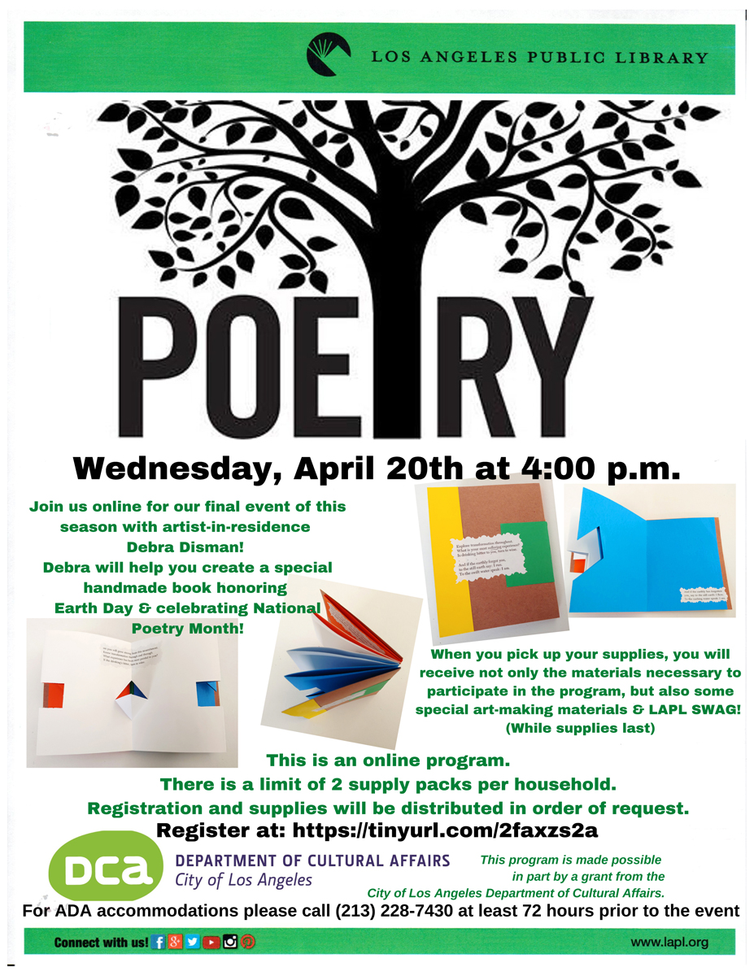
“WE WRITE THE BOOK”
Artist Residency at the
West Valley Regional Branch Library
Debra Disman - Artist in Residence
Supported by
The City of Los Angeles
Department of Cultural Affairs
Welcome to the culmination of our “We Write The Book” artist residency in bookmaking at the West Valley Regional Branch Library, supported by The Los Angeles Department of Cultural Affairs.
We hope you enjoy seeing this overview of our bookmaking program workshops and Culmination Event for our 2021-2022 Residency!

Slide 2
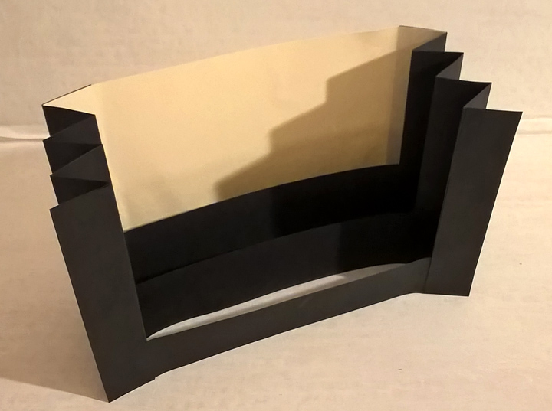
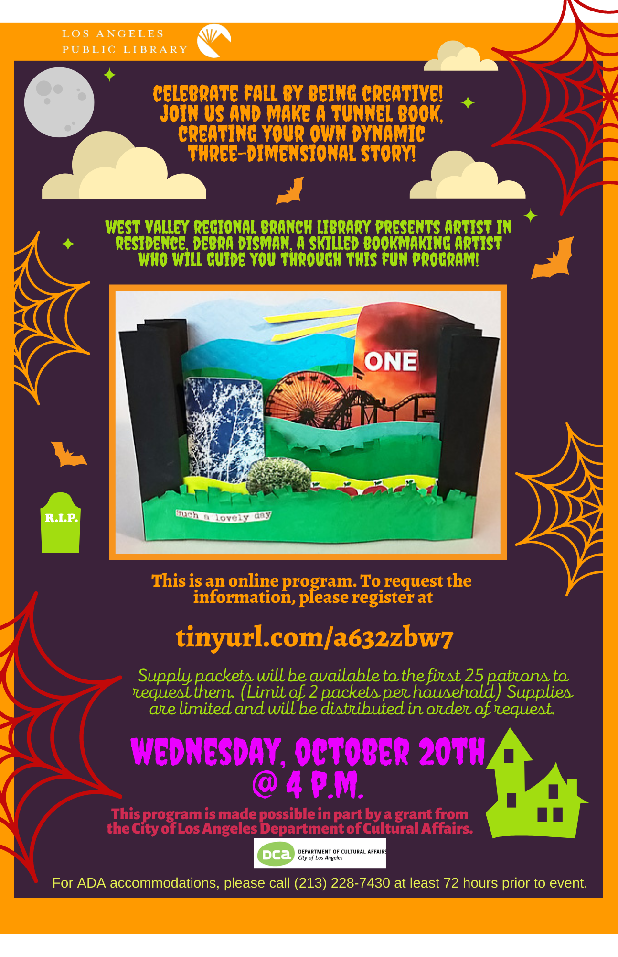
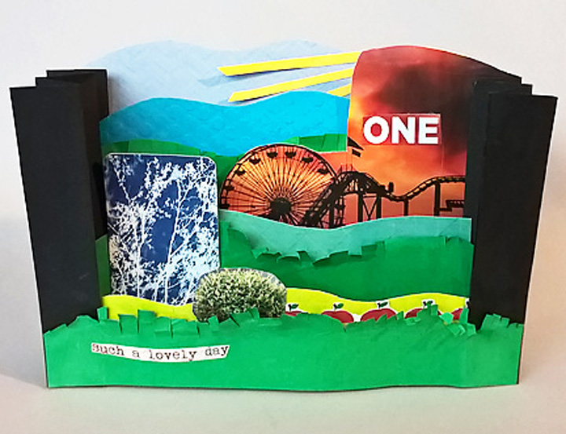
October 2021
Making Story Magic for the Festive Fall Season!
Tunnel Book
Creating a structure and developing a three-dimensional story made completely out of paper!

Slide 3
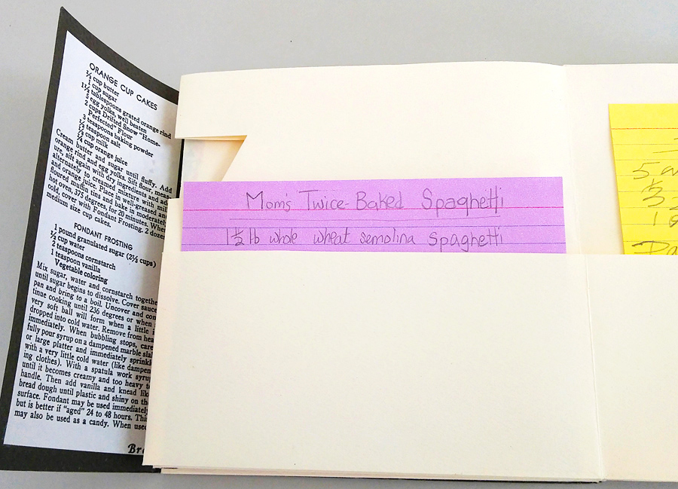
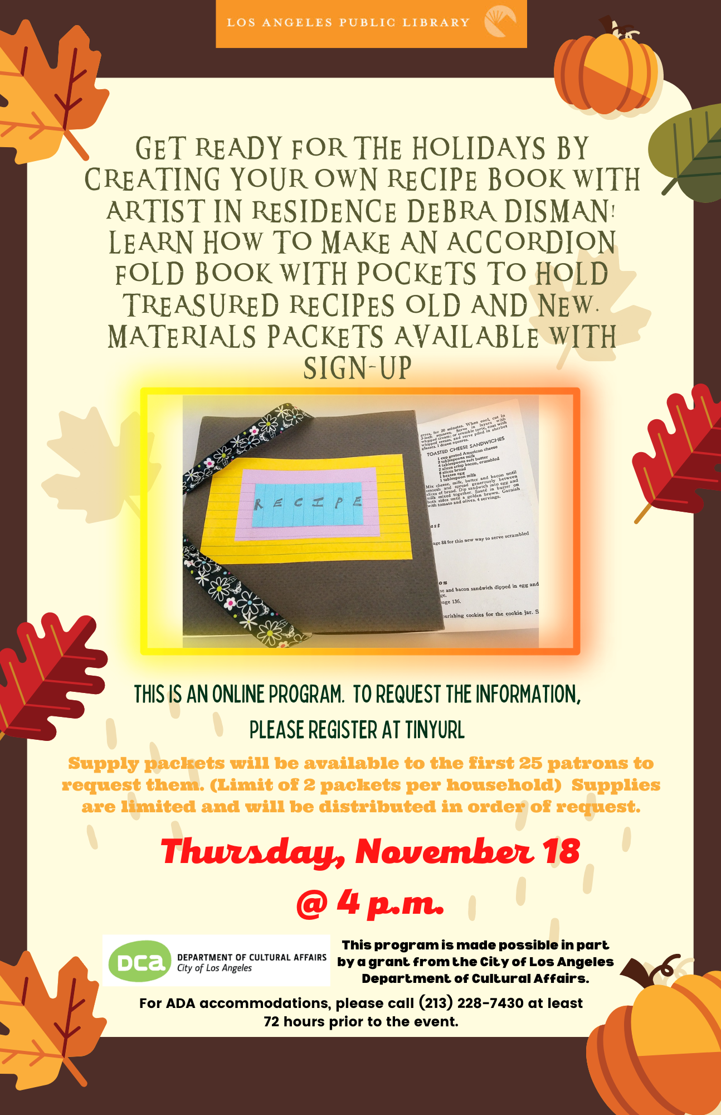
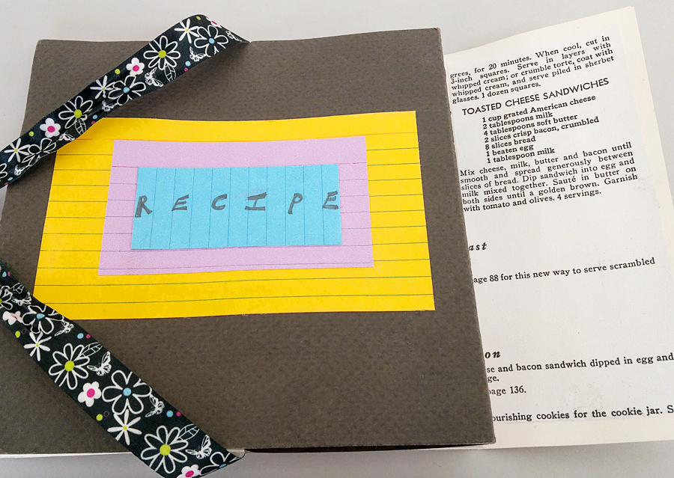
November 2021
Getting ready for Winter Holiday Feasts!
Recipe Book
Making an Accordion Fold Book with Pockets to hold treasured recipes.

Slide 4
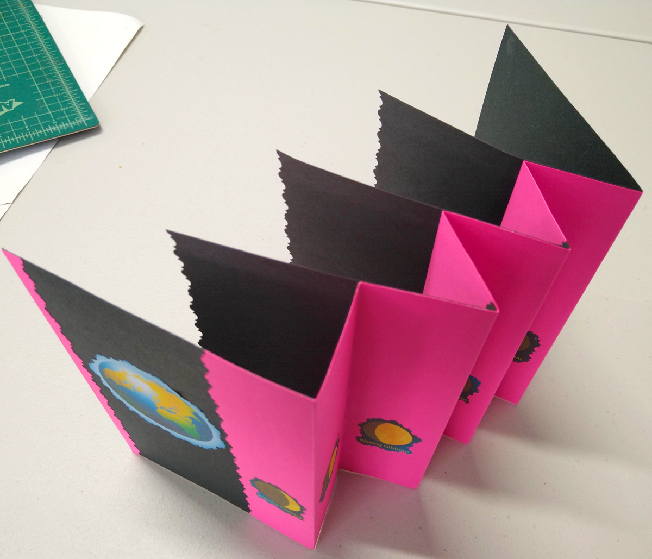
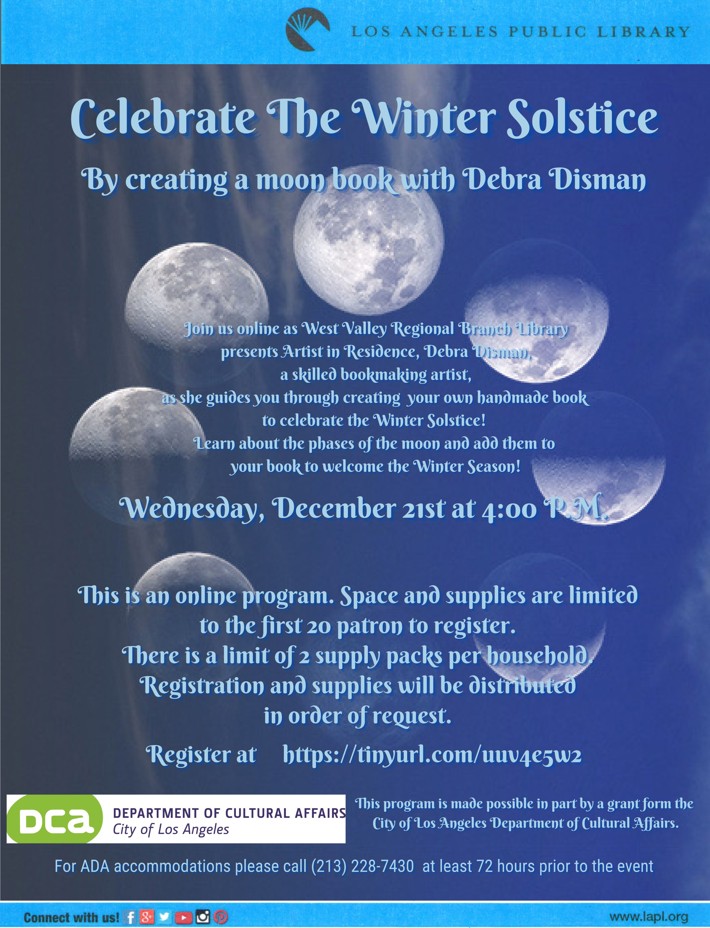
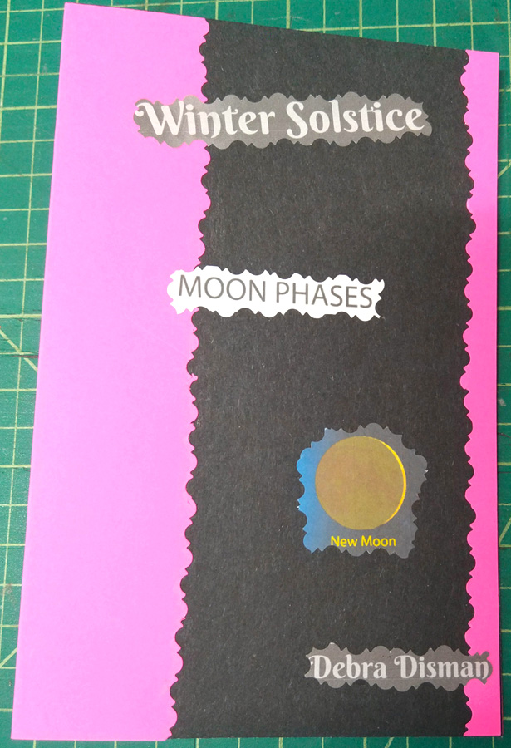
December 2021
Celebrating the Winter Solstice and the New Year.
“Moon” Book
Making a “Folded Fan” Book to hold the Phases of the Moon!

Slide 5
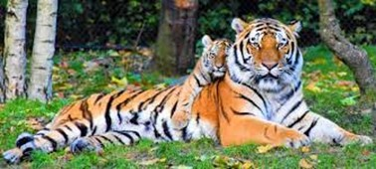
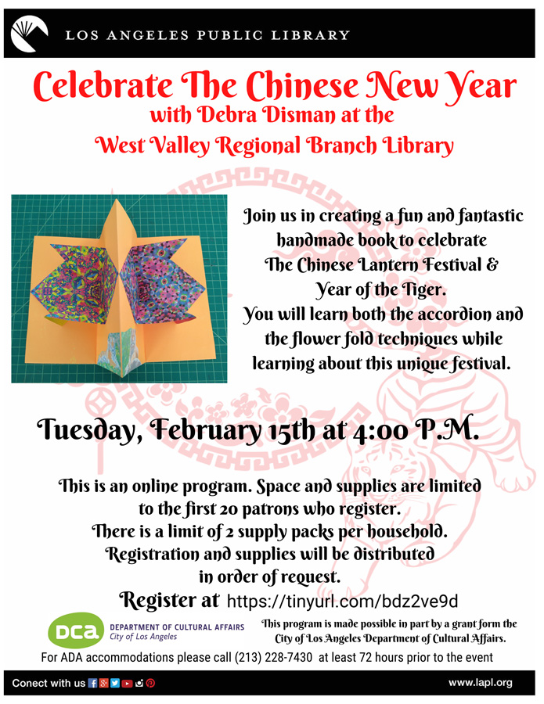
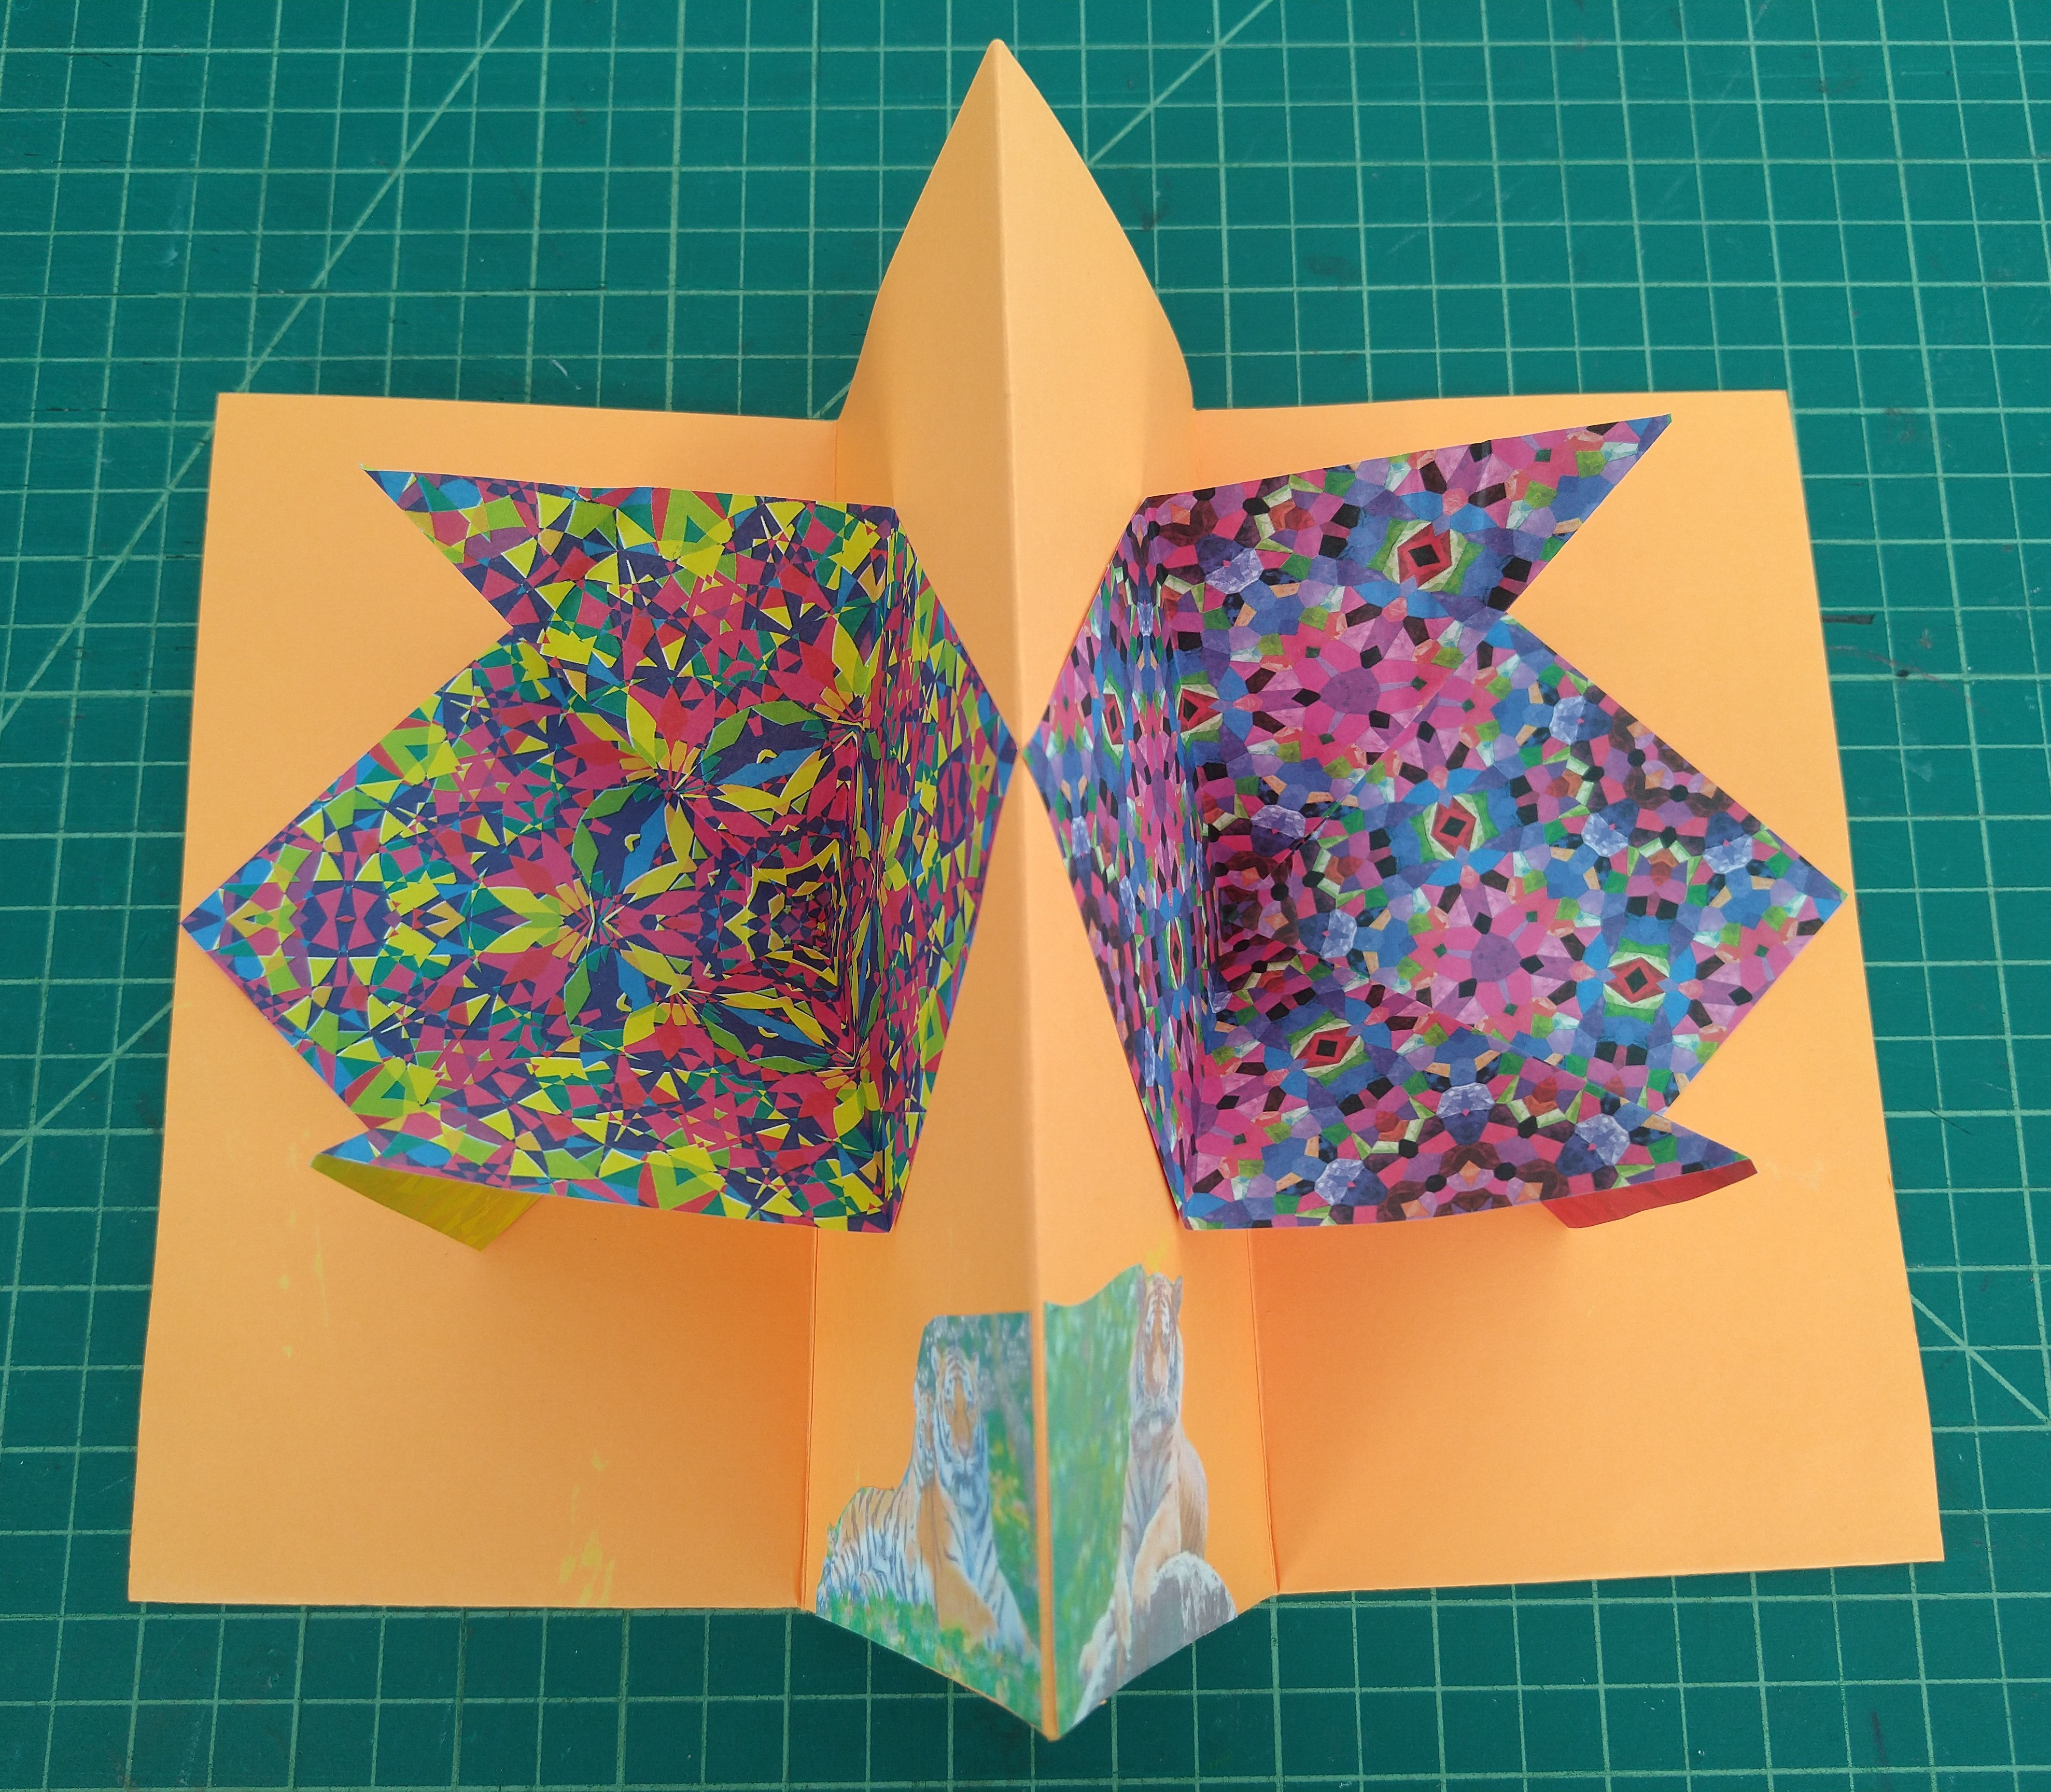
February 2022
Connecting with Chinese New Year: Year of the Tiger!
Accordion Fold Book with Flower Folds
Learning about The Chinese Lantern Festival.

Slide 6
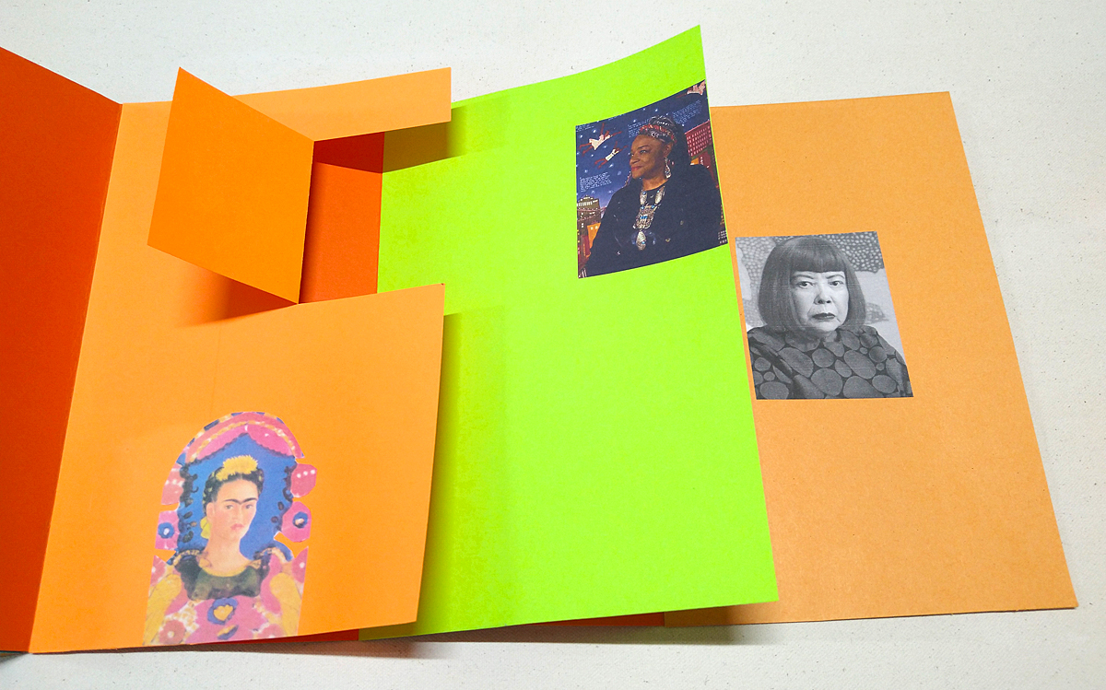
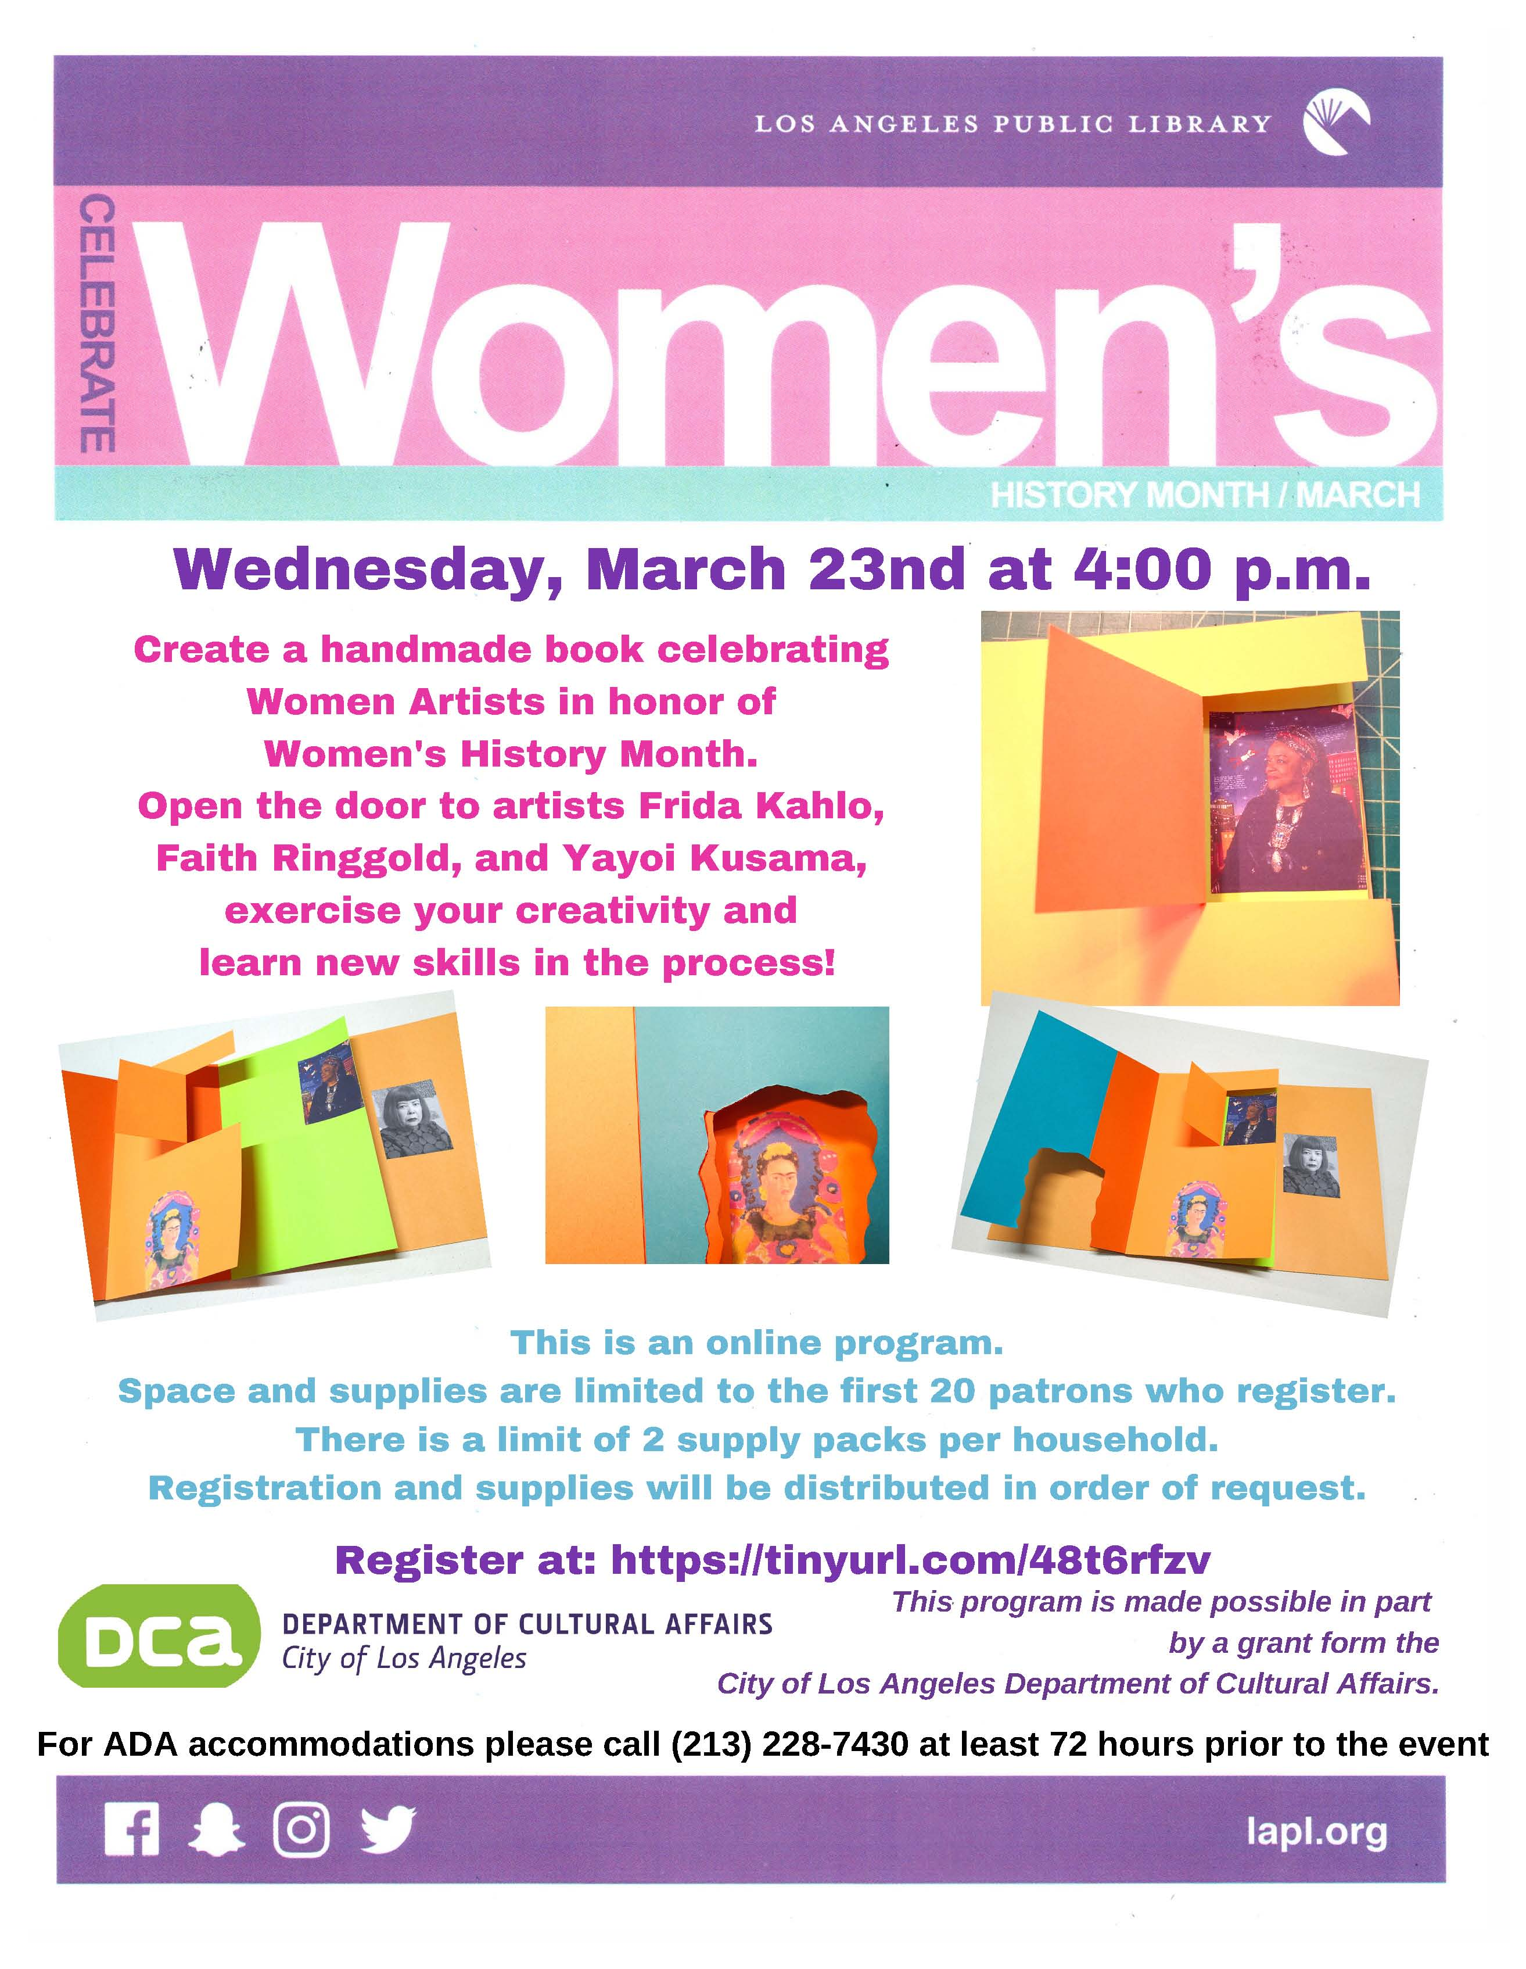
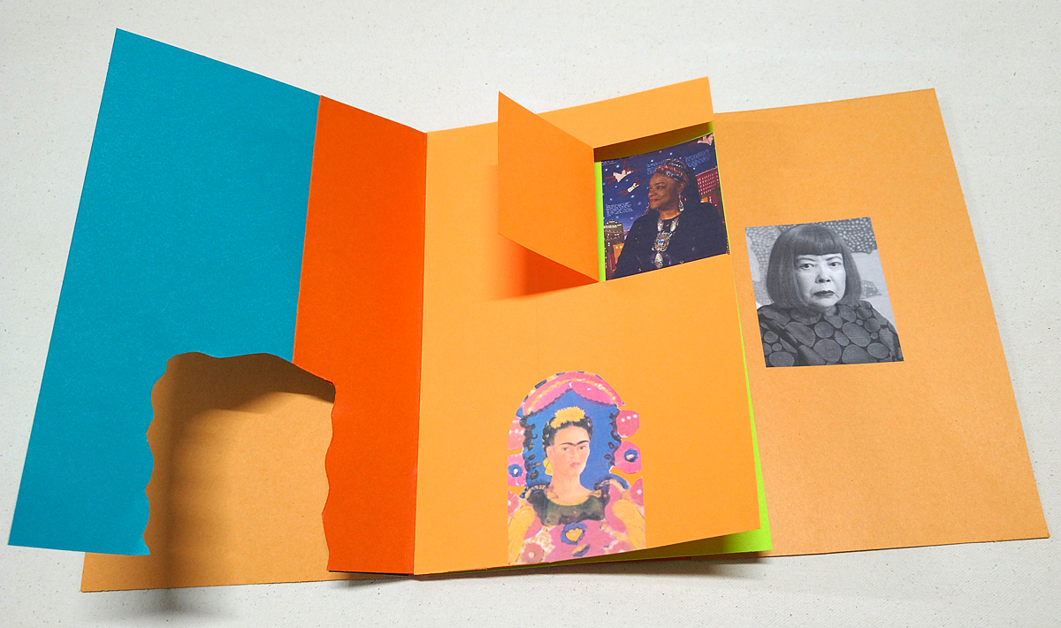
March 2022
Honoring Women’s History Month by celebrating Women Artists!
Full Page Flag Book with Windows and Doors
Opening the door to incredible artists:
Frida Kahlo Faith Ringgold Yayoi Kusama

Slide 7
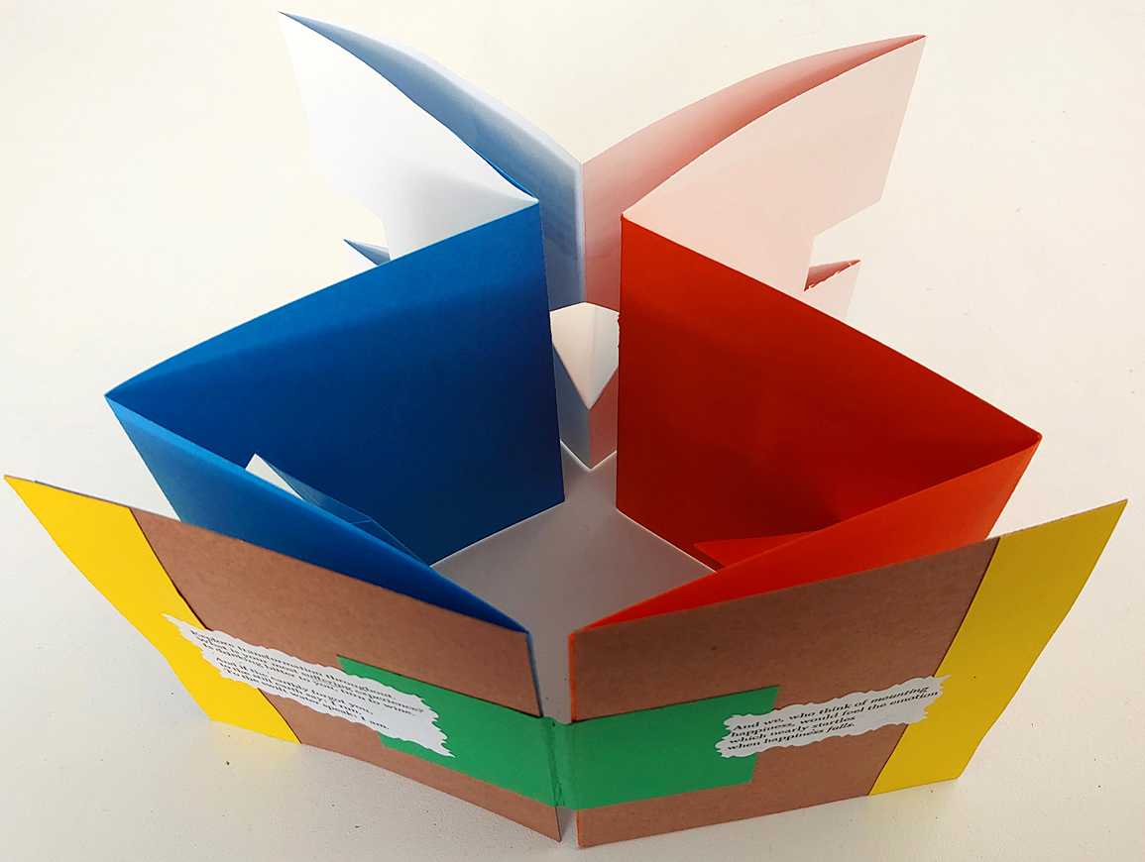
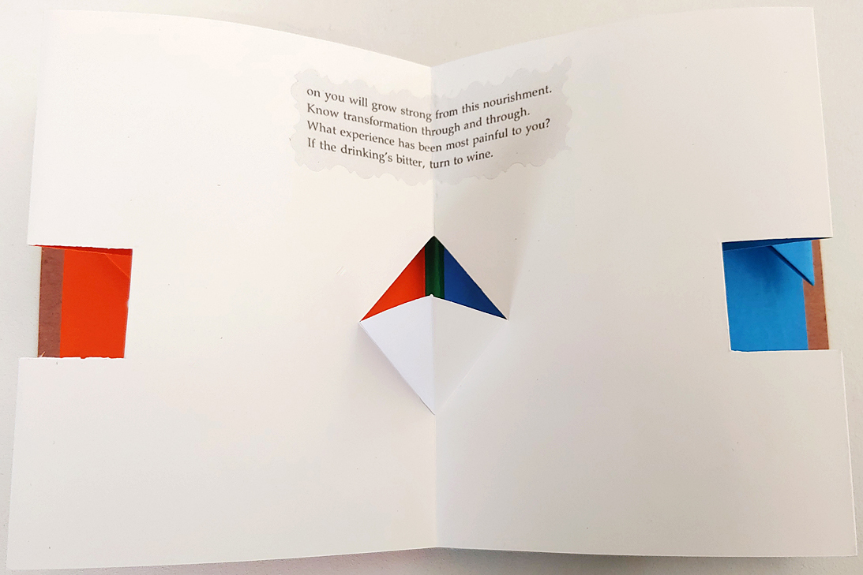
April 2022
Residency CULMINATION EVENT!
Celebrating Earth Day & Honoring Poetry Month!
Closed Spine Accordion Book with Pop-ups
Exploring poetry with themes of Earth and Nature!

Slide 8
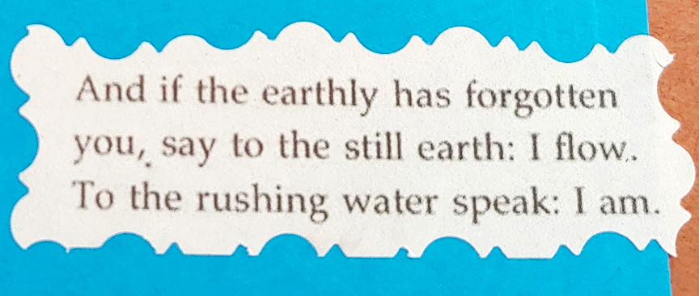
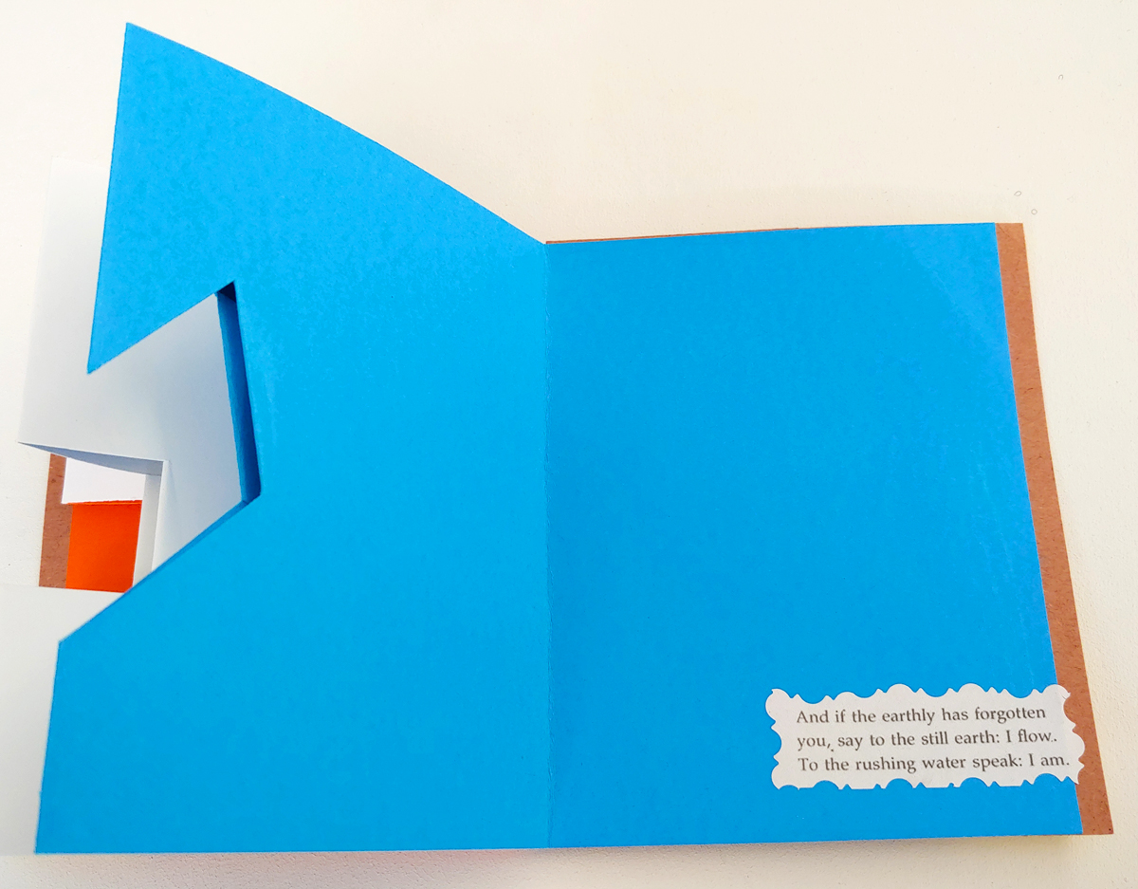
“WE WRITE THE BOOK”
Artist Residency at the
West Valley Regional Branch Library
Debra Disman - Artist in Residence
Supported by
The City of Los Angeles
Department of Cultural Affairs
We hope you have enjoyed seeing our bookmaking projects from our “We Write The Book” artist residency in at the West Valley Regional Branch Library.
Many thanks to The City of Los Angeles Department of Cultural Affairs
for their support of the program, and for their continued support of the arts, communities, and artists in Los Angeles.

